Slide 1
Unit 1. Computing Environments
1.8 Installing Python, IDLE and Atom
Install the latest version of Python
Install the Integrated Development Environment (IDLE)
Install the IDE Atom

Slide 2
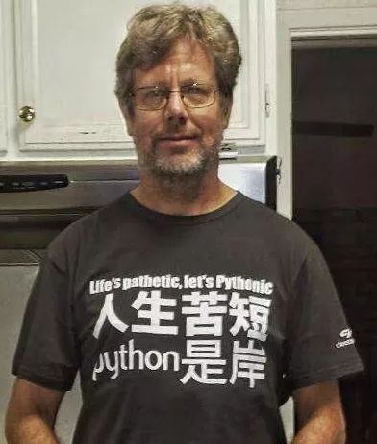
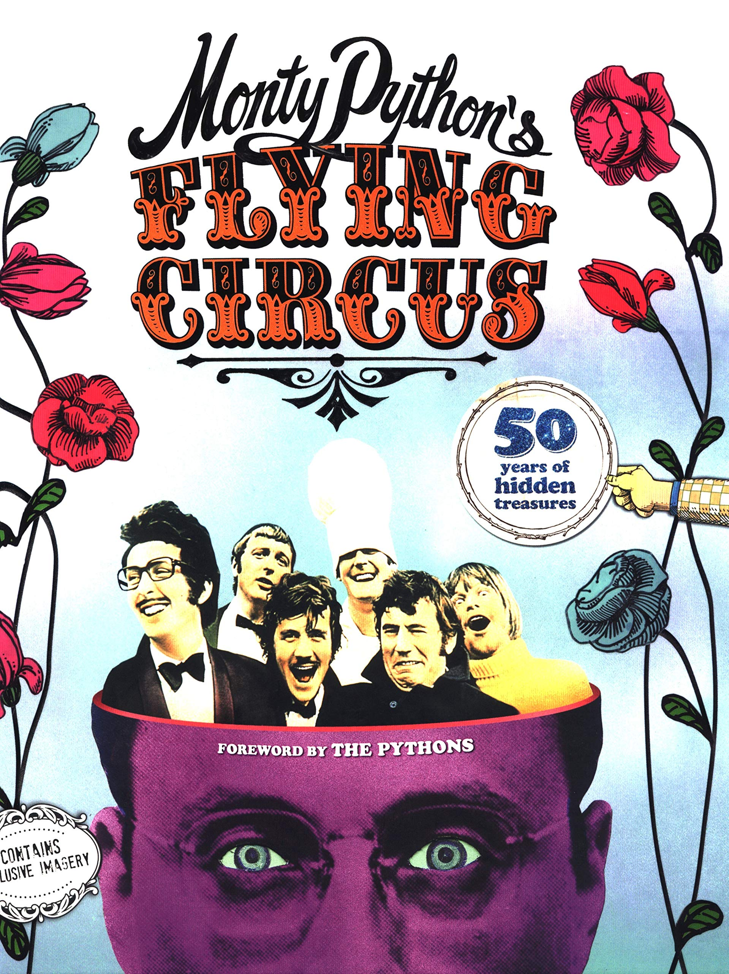
About Python
Its name comes from a 1970s British comedy sketch television show called Monty Python’s Flying Circus . The development environment IDLE provided with Python comes from the name of a member of the comic group.
https://www.youtube.com/watch?v=LNSk1z0dpJ8
The Creator of Python -- Guido van Rossum
https://www.youtube.com/watch?v=J0Aq44Pze-w

Slide 3
Install Python
Page 799 of the textbook:
Starting Out with Python by Tony Gaddis

Slide 4
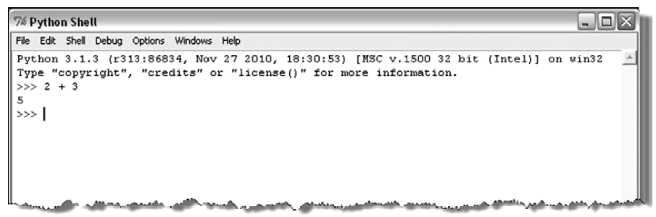
Python Shell
Python is most commonly translated by use of an interpreter. Thus, Python provides the very useful ability to execute in interactive mode. The window that provides this interaction is referred to as the Python shell . Interacting with the shell is much like using a calculator, except that, instead of being limited to the operations built into a calculator (addition, subtraction, etc.), it allows the entry and creation of any Python code.
Here, the expression 2 + 3 is entered at the shell prompt ( >>> ),
which immediately responds with the result 5.

Slide 5
Python IDLE
An IDE is a bundled set of software tools for program development. This typically includes an editor for creating and modifying programs, a translator for executing programs, and a program debugger. A debugger provides a means of taking control of the execution of a program to aid in finding program errors.

Slide 6
Using Python IDLE
Page 803 of the textbook:
Starting Out with Python by Tony Gaddis

Slide 7
Install Atom
https://www.youtube.com/watch?v=DjEuROpsvp4

